Slide 2


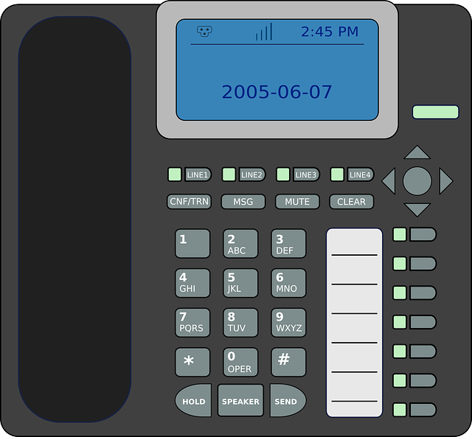






Network Security – What are VPNs
Headquarters
Virtual Private Networks
Secure communications over insecure networks
Protects privacy
Public Network
(Internet)
Remote Office

Slide 3


Network Security – Remote Access VPN
VPN Client
Headquarters
Public Network
(Internet)

Slide 4
Network Security – Site-to-site VPN
Branch 1
Headquarters
Public Network
(Internet)
Branch 2

Slide 5
Network Security – Split-tunnel
VPN Client
Headquarters
www.not-work.tv
Public Network
(Internet)

Slide 6
Network Security – Tunneling Protocols
Creates tunneled communications
Does not secure communications
Coupled with encryption protocol

Slide 7
Network Security – Tunneling Protocols and Encryption
Protocol | PPTP | L2TP | SSTP | IKEv2
Pros | Widely supported | Widely support Strong Security | Firewall Traversal | Mobility Support
Cons | Weak | Performance Complex Firewall blocking | Compatibility (Windows only) Proxy Issues | Limited Support Firewall blocking
Encryption | Microsoft Point-to-point Encryption (Weak) | IPSec (AES, Certificates) (Strong) | SSL 3.0 (Weak) | IPSec (AES, Certificates) (Strong)
Notes:
IPSec UDP port 500 can improve performance over TCP but is weaker security and blocked by firewalls
Remember ports
PPTP ports = 1723
L2TP port UDP port 500 encryption key management
L2TP port UDP port 4500 (NAT Traversal)
L2TP port ESP 50
L2TP port AH 51
L2TP tunneling port is 1701
SSTP port 443

